Slide 1


Slide 2
What is HR Duo
HR Duo acts as a centralized digital portal for managing leave and performance.
Key Features:
Self-Service Portal: You can update personal details, view contract details, and access company documents in one secure location.
Leave Management: Requesting time off and viewing leave balances is digitized, removing paperwork.
Performance & Goals: You can track goals, receive feedback, and complete performance reviews through the system.

Slide 3
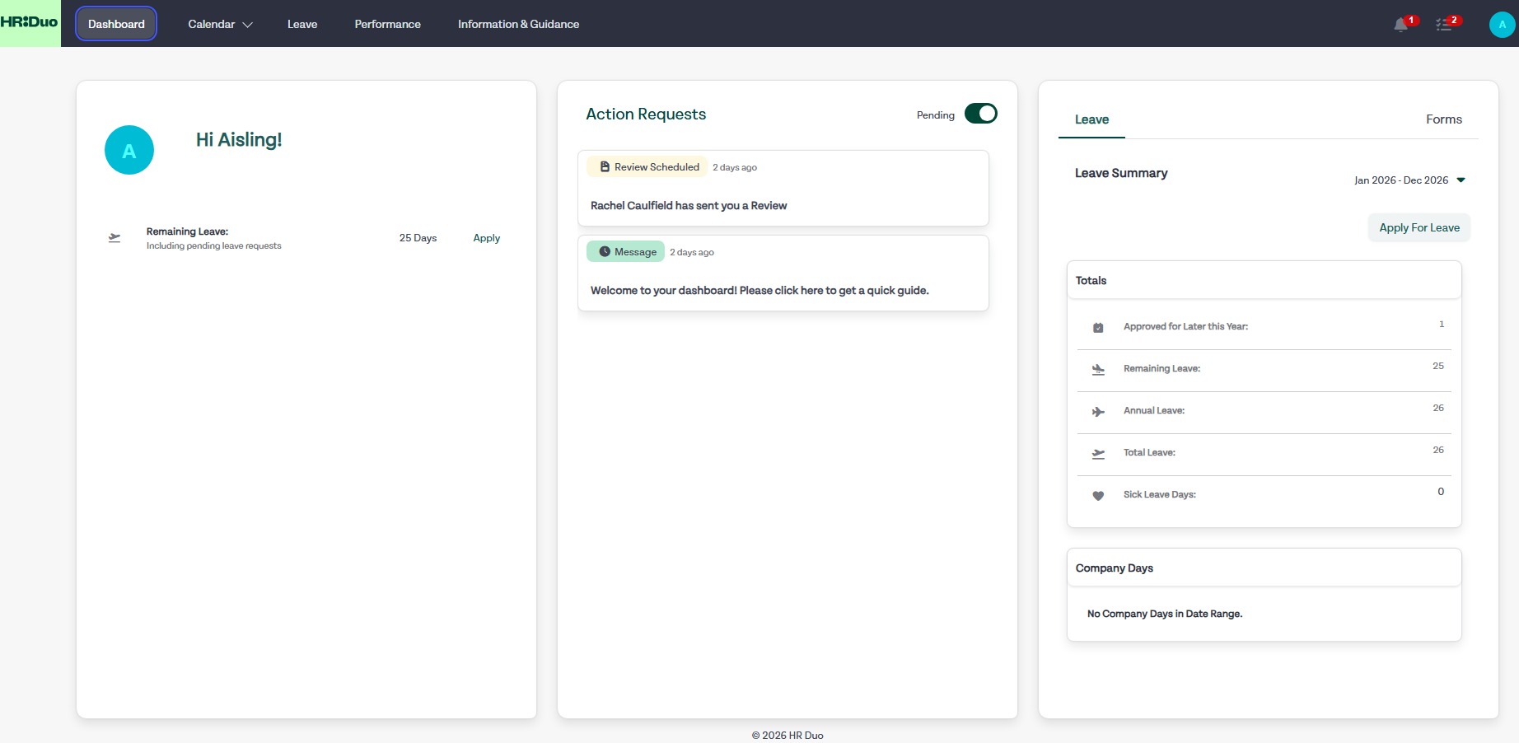
Dashboard
1st tile shows the amount of remaining annual leave days, including pending leave requests. You can also Apply for leave here.
01
2nd tile show any requests you need to complete on HR Duo, be that signing of a HR Doc, notifications etc.
02
3rd tile is your Leave Summary and you can also Apply For Leave here too.
03

Slide 4
As a LTD Consultant, your annual leave balance will show as 0.
However, we do ask that you submit leave on the portal for visibility purposes. Your Manager will get a notification and will follow process for approving leave.

Slide 5
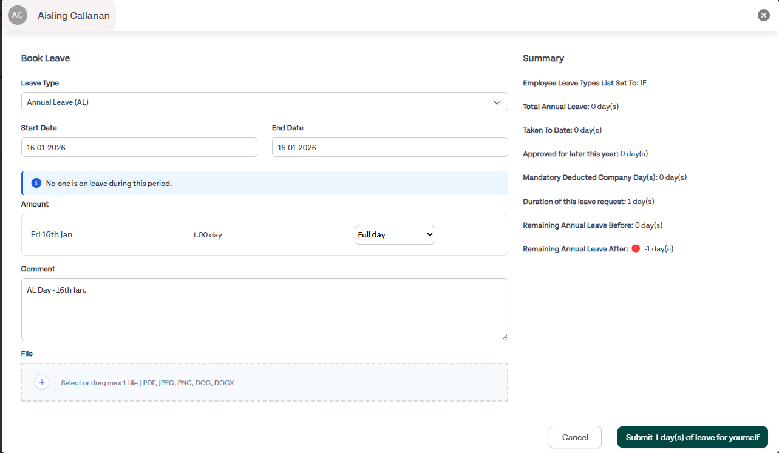
Apply For Leave
Click on Apply For Leave
Choose your Leave Type
Enter the Start Date and End Date
Enter the Amount: Full Day, Half Day AM or Half Day PM
Enter a Comment if you wish
You can also upload documentation if you wish
Once submitted and your Manager approves, you will see the activity in your Leave Summary tile on the Dashboard
Sick Leave will be routed to the Finance team in LSC who will approve your sick leave based on certified, uncertified, statutory pay etc.

Slide 6

Calendar
The Calendar shows the following: 1. Leave
2. Performance – if your Manager books Performance Reviews, it will show on this calendar
3. Working From Home – you will apply for working from home on this calendar, by heading to the days you plan to work from home and click on the + sign.

Slide 7

Performance
Individual Objectives: You can add your own specific, measurable goals to drive growth, improve skills or achieve desired outcomes
Go to the Performance module.
Select Objectives
Choose My Objectives
Click Add Objective
Note the Priority of the Objective.
Select a Start and Due Date of the Objective.
Title and Describe the Objective.
Add a File if needed.
Click Submit
You will then be able to view your Objective.

Slide 8
How Performance Reviews Work
Once your HR Manager assigns you a Review, it will show on your Dashboard under Action Requests.
Click on the request.
Click on Complete Review.
Complete the review your HR Manager assigns to you.
To review completed Reviews, head to Performance and click on My Reviews.
Within here, you can see whether your HR Manager has completed the review on their end or not.
You will also be able to see your HR Manager’s responses too

Slide 9

Information & Guidance
Within here, you can see all policies from the Employee Handbook broken down into easier to find sections.

Slide 10
View Profile
Chat Log: Within here, any conversation between you and your Manager will be stored here. Your Manager can only begin the Chat Log.
Contract Details will host all your contract details
Personal Details will host all your personal detail including email address, phone number, banking info for payroll etc.
Resources will host any files in relation to your contract, HR policies and any polices signed by you will be stored within Company Documents.
System details will host your Manager, groups and departments you belong to including any permissions.
You can also add any Training & Qualification to this tab.

Slide 11
View Profile
Tabs you can ignore:
Equipment | Right to Work
Medical Details | Skills
On-boarding | Vaccines

Slide 12

Any Questions?
Any questions on the portal or functionality of the portal, please email support@lsc.ie and a member of our team will get back to you or contact your HR Manager – Rachel O’Riordan: roriordan@lsc.ie
.

